Slide 2
Objectives
Understand how sound is sampled and stored in digital form
Be able to represent a short sound file in binary
Explain how sampling intervals and resolution affect the size of a sound file using the terms:
Sample rate
Sample resolution (bit-depth)
Explain the trade-off between file size and the accuracy of the recording

Slide 3
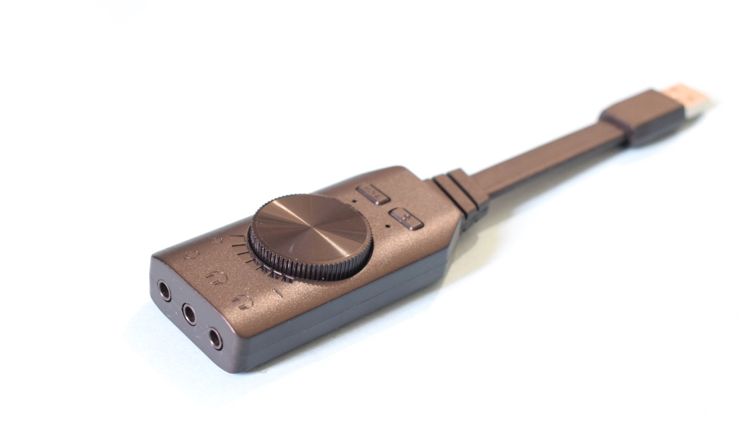

Starter
A computer uses binary 1s and 0s
How do you think this is able to store sound?

Slide 4
Analogue to digital conversion
Analogue sound signals are continuous
Digital signals are discrete (not continuous)
Sound is digitised by repeatedly measuring and recording the sound wave
\
1 0 1 0 1 0 1 0 1 0 1 0

Slide 5
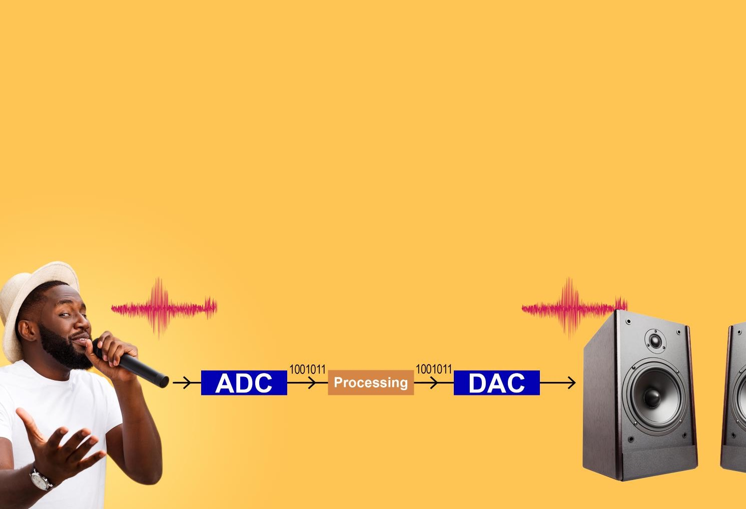

Analogue to digital convertors
Sounds must be converted into a digital form in order to be stored and processed by a computer
An Analogue to Digital Convertor (ADC) is used to convert inputs to digital signals
A Digital to Audio Convertor (DAC) is used to convert digital signals to outputs

Slide 6
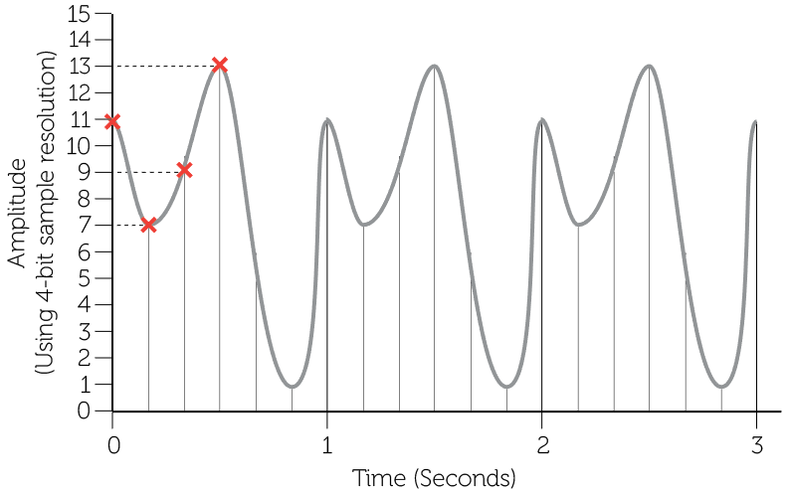
Sound sampling
A sound sample is a measurement of amplitude of a sound wave at a given time
Sound is sampled using a bit depth and sample rate
The sample resolution determines how closely the wave is sampled on the y-axis

Slide 7
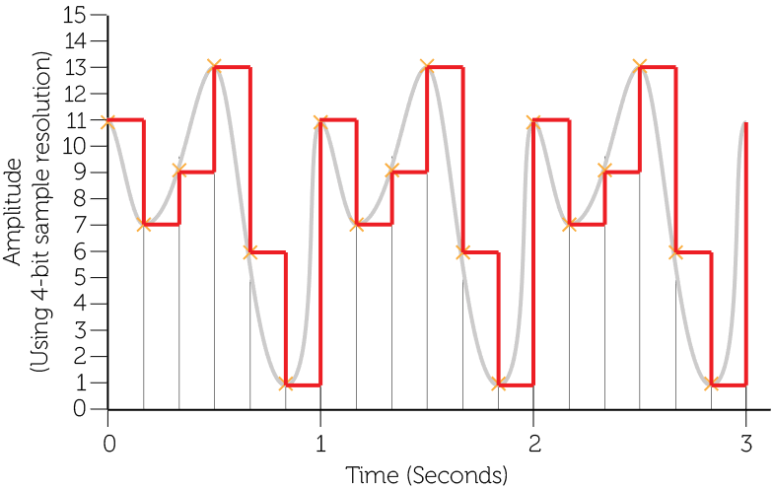
Sound sampling
The sample rate is the number of samples taken per second
It is measured in hertz (Hz)

Slide 8
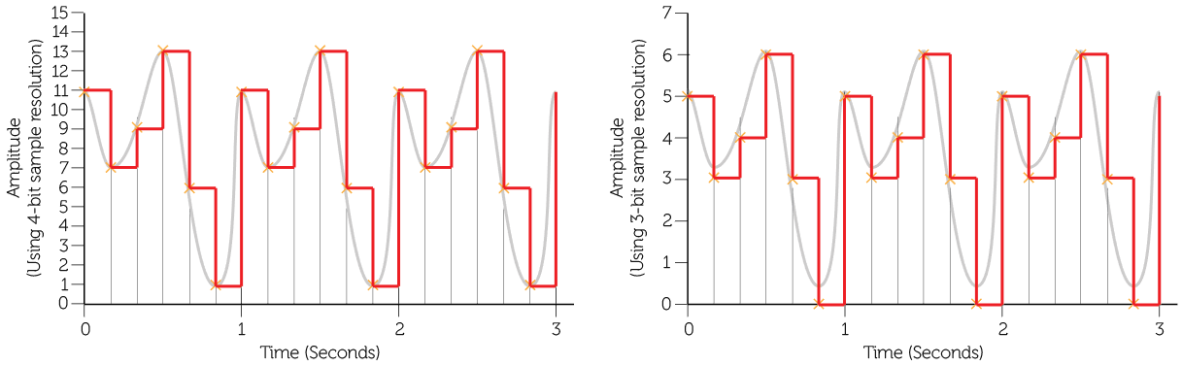
Sample resolution
The number of bits (audio bit depth) used to record each measurement is known as the resolution
More bits used per sample enables the height of the wave to be more accurately measured but increases file size
Higher (4-bit) resolution
Lower (3-bit) resolution

Slide 9
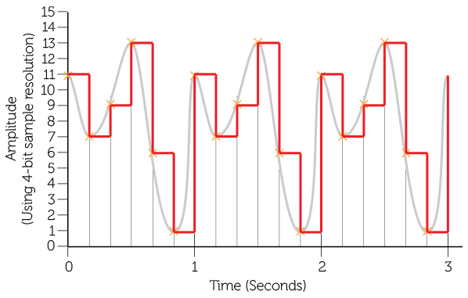
Hertz
Sample rate is usually measured in hertz (Hz)
1 Hz = 1 sample per second
CDs are usually sampled at 44,100 Hz (44.1 kHz)
What is the sample rate in hertz of the following sample?

Slide 10
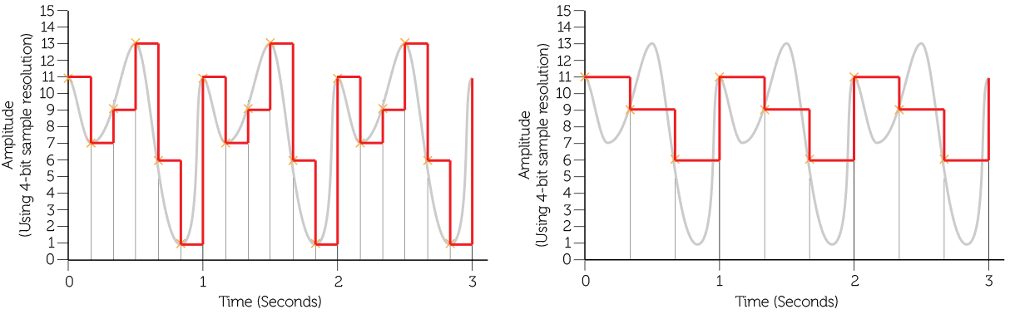
Sampling rate
The frequency or sample rate per second affects the level of detail in the digital representation
The greater the frequency, the greater the accuracy, and file size
Higher frequency
Lower frequency

Slide 11
Calculating sound file sizes
File size (bits) = sample rate × resolution × duration
6 samples per second × 4-bit resolution × 3 seconds =
72 bits / 8 = 9 bytes

Slide 12
Worksheet 5
Complete Task 1 on Worksheet 5

Slide 13
Digitised sound quality
Recording quality improves:
the more frequently we sample the sound
the more accurately we record the wave height
Increasing the sampling rate (frequency) means recording more data points
Increasing the resolution (bit depth) improves the accuracy of each data point
What happens to the size of the sound file if the frequency and bit-rate are increased?

Slide 14
Worksheet 5
Complete Task 2 on Worksheet 5

Slide 15

Our hearing range
We can hear sounds between 20-20,000 Hz
Younger people can hear sounds at a higher frequency
Try the test sound and see how high you and your class can hear

Slide 16


Lossy compression – MP3
Lossy compression removes sounds that we can’t easily hear or that least affect the perceived playback quality
Lossy compression leaves out some data from the original so can negatively affect the sound quality
However, a minute of music can be stored in 1 MB of an MP3 file, but needs 10 MB of an uncompressed WAV file
This is useful for storing, downloading or streaming

Slide 17
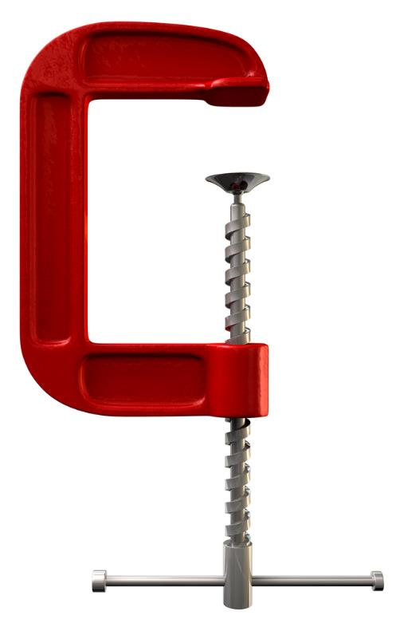
Lossless compression
Lossless compression formats are able to reduce the file size when compressed but do not lose any information
The following music file formats are lossless:
FLAC (Free Lossless Audio Codec)
ALAC (Apple Lossless Audio Codec)
WMA Lossless (Windows Media Audio)

Slide 18
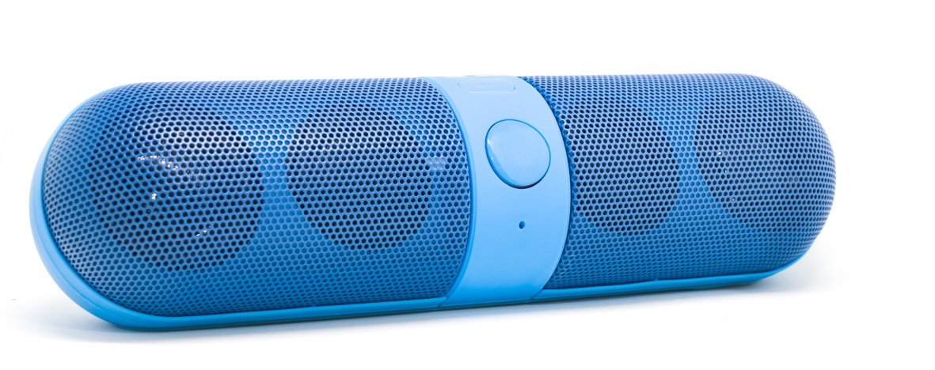
Other file formats
WAV and AIFF files are uncompressed audio files
Lossy file formats are still very popular as they reduce the file size well
MP3 (MPEG-1 Audio Layer III)
AAC (Advanced Audio Coding) – typically higher quality than MP3

Slide 19

Plenary
In pairs, take turns to test each other on the following questions
The sample rate is measured in what unit?
The number of bits available to store each sample is known as what?
What is the formula for calculating the size of an uncompressed music file?
Track1.wav uses a sample rate of 20 kHz, Track2.wav uses a sample rate of 10 kHz. Which file is the higher quality? Which is the larger file size?

Slide 20
Plenary
In pairs take turns to test each other on the following questions
The sample rate is measured in what unit? Hertz (Hz)
The number of bits available to store each sample is known as what? Resolution (bit depth)
What is the formula for calculating the size of an uncompressed music file? Sample rate x resolution x duration
Track1.wav uses a sample rate of 20 kHz, Track2.wav uses a sample rate of 10 kHz. Which file is the higher quality? Which is the larger file size? Track1 is higher quality and a larger file size

